Slide 1

Learning Handwriting using EMNIST and Neural Networks

Slide 2
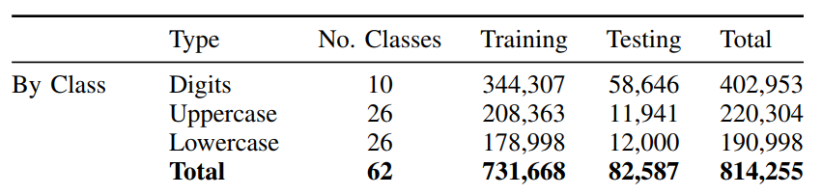
Extended Modified NIST (EMNIST)
Derived from the NIST Special Database 19, these datasets are intended to represent a more challenging classification task for neural networks and learning system.

Slide 3
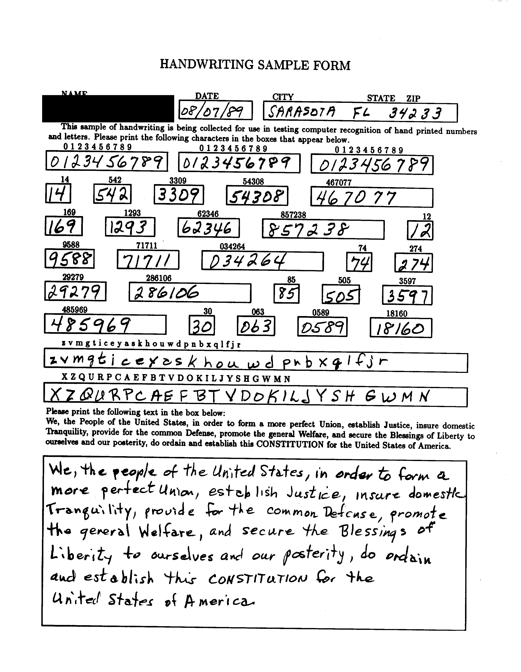
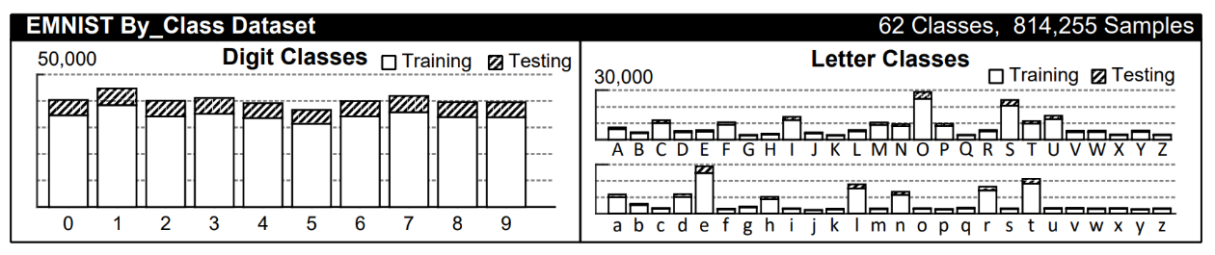
EMNIST Continued
Taken from handwriting sample forms
Using By_Class Dataset (unbalanced)

Slide 4
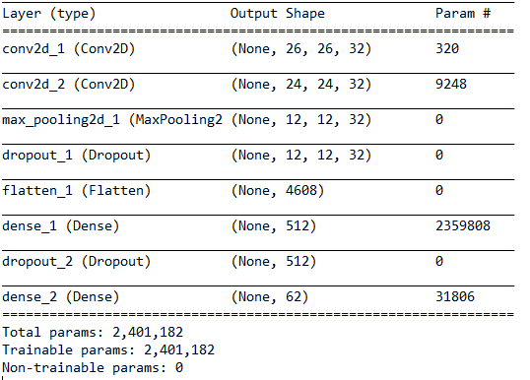
Model Summary

Slide 5
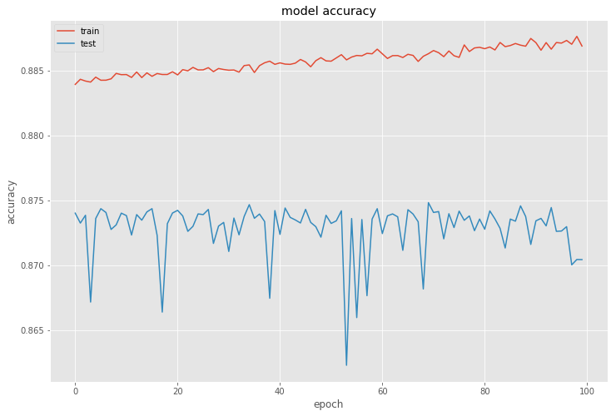
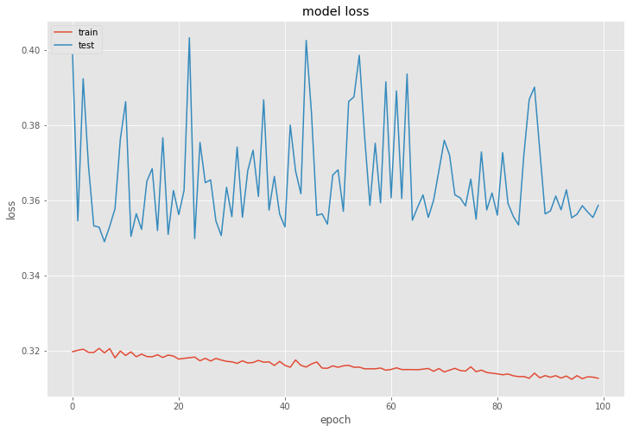
Model Summary
Epochs = 100
Batch size = 256
Test score: 0.358586772516
Test accuracy: 0.870438348392

Slide 6


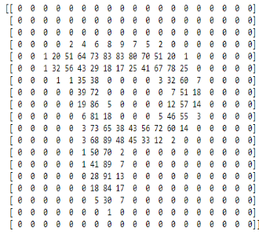
Prediction Process
Each image was 28 x 28 = 784 pixels
Applied thresholding to removed all colors except black and white
Inverted colors to determine where pixels were
Ran each image through the model to predict letter

Slide 7

Next Steps
OpenCV
Using contours to breakout each digit or letter and return value
Run across multiple forms and return values to output
Record dataset to build additional model to determine document type
Uses
Audit (full sample testing)
Record retention and identification

